Slide 1

R U up on R? Society of Actuaries Health Meeting – Philadelphia, PA 15-June-2016 10:00 – 11:30 am
By Dave Snell, ASA, MAAA, CLU, ChFC, FLMI, ACS, ARA, MCP
Technology Evangelist
RGA
14-June-2016
Notes:
Thank you for allowing me to come and speak with you today. In this session we are not going to make you proficient in R. But I hope we increase your interest in it and that we give you some tips for getting started with it.

Slide 2
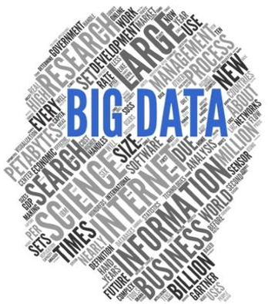
Why Learn Yet Another Language?
Actuaries who want to stay viable in the data analysis space need to upgrade their skill sets beyond just spreadsheets.
Data is getting BIGGER!
R is one (of many) new tools for data analysis and presentation.
gigabytes → terabytes → petabytes → exabytes → zettabytes … → yottabytes → brontobytes → geopbytes → … oh, my!
Notes:
Supposedly, we are up to five zettabytes of data per year; but keep in mind that all the data from human existence to 2003 is exceeded every few days now.
100 hours of YouTube video content is uploaded every minute! How many of them show your applicant smoking cigarettes or other items? How many show lifestyle activities you would not wish to insure? Who voluntarily uploaded this information for the world to see? In many cases, they, the insurance applicants did!

Slide 3
Big Data is all around us – much publicly posted
1% sample of 332,900 tweets in 5 seconds
> proc.time()-ptm
user system elapsed
0.08 0.00 5.02
>
> tweets.df <- parseTweets("tweets_sample.json")
332900 tweets have been parsed.
> tail(tweets.df$text,20)
[1] "RT @yuteesonyu: ไม่เห็นด้วยกับรูปนี้เลย ไม่ใช่คนไทยทุกคนที่คิดแบบนี้ แล้วก็ไม่ใช่ฝรั่งทุกคนที่คิดแบบนี้ คนไทยดีๆก็มี ฝรั่งแย่ๆก็มี https://…"
[2] "Psychedelic Padded Pipe Pouch by https://t.co/GRpeEhB0n3 https://t.co/rDRSdbBN5v via @Etsy #hippy #weed #smoke #can
[3] "RT @teed_chris: WISCONSIN,, TRUMPSTERS, AMERICANS, WE COME TOGETHER FOR A BATTLE TODAY, AND FOR OU
[4] "@tabo_luv_ST 音だけ流れ続けて画面真っ暗～ｗｗｗ"
[5] "@nozomieiei …知ってる"
[6] "So much pain inside him.Immense betray from Yulin humans #StopYuLin4ever https://t.co/EZaxTDJ5q0"
[7] "RT @sylvmic: Check out these awesome @5SOS headphones!! https://t.co/9hkaYaABwM #essential5SOS https://t.co/WfIzaxV
[8] "RT @skywalkgrier: et le 3x01 qd il l'appel pr son anniv alors qu'il a perdu son humanité https://t.co/yNI7qIE0VU"
[9] "猫をあやす棗さんが可愛すぎて歯磨き粉噴出した"
[10] "こんな時間に腹減り"
[11] "RT @tomozh: 大変だった時に使うハンコできた https://t.co/48VaQbVcpx"
[12] "あっ"
[13] "モイ！iPhoneからキャス配信中 - https://t.co/ccrG6sHn43"
[14] "RT @KSeriesAD: พัคโบกอม ถ่ายแบบให้กับแบรนด์ MontBell คอลเลคชั่น S/S 2016 / หล่อ น่ารัก \xed��\xed�\u0095 https://t.co/lKAxtVcGrD"
[15] "RT @SHXBL94_: ไม่ใช่คนที่โลกส่วนตัวสูงครับ ไม่ใช่คนที่เข้ากับคนยาก ตรงกันข้ามผมเข้ากับคนอื่นง่าย แต่ผมแค่เลือกคนที่จะให้รู้เรื่องส่วนตัวของ…"
[16] "RT @ARS_C_bot: 青「パクに土偶と埴輪の違いは解りますか？って聞いてみたら\n緑『解りますよ！土偶はこう(土偶のポーズ)で埴輪はこう(埴輪のポーズ)ですよね！』って答えられた。そういう話じゃない」"
[17] "@kurooshiteru @tohruoikawa don't worry. Even in Japan I wouldn't have done that. What do you take me for?? Some weeb??
[18] "Ladies https://t.co/ELNALcLYyu"
[19] "【定期】すべての人に好かれる気はないし必要ないと思ってる。ごく少数の仲のいい人が出来ればそれでいい。"
[20] "@june7845 고양이귀랑 꼬리랑 발 달고 고양이란제리랑 스타킹 입고 사진찍자"
Notes:
Using an R program from Dihui, I captured this from Twitter in 5 seconds. Note the various languages and topics. It is as if we suddenly had the ability to digitize and classify and analyze the wind around us or the sunlight streaming down on us. The airwaves are filled with conversations and they contain a lot of information – some of it useful for underwriting.

Slide 4
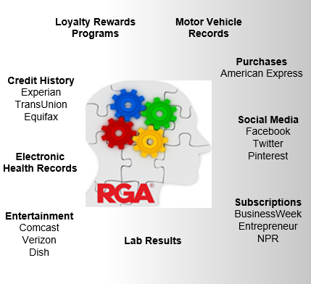
How will they dramatically change the future of health insurance?
The internet of things will know more about you than any personal doctor could ever hope to know about you.
Wearables; watches, shirts, socks, etc.
Embeddables: pills, nanobots, labs in your bloodstream
Appliances: smart fridge, ‘lav’ results, Kindle reading, movies and shows watched
Consumables: the telltale hamburger, bragging broccoli
These go beyond Big Brother’s wildest dreams!
Notes:
What if all your pictures could be scanned for the use of tobacco, your cable company revealed whether you have the premium ‘couch potato’ package, your wrist monitor was streaming vitals by the minute wirelessly, your fridge was reporting on your food purchases, your shoes relayed how much you walk, your clothes were all gathering info and sending it along. What if the prescription pill you take has an embedded nanochip that travels through your bloodstream and sends signals to your smartphone, your Kindle and Google analyze your current reading preferences and determine your psychological state, and your genome, microbiome, and all the other omes are tattling on you by the second to a huge ongoing model that changes your ongoing premium accordingly?
Where is it coming from?
APS ➔ EHR : based on GP who sees you once a year for 15-30 minutes
You all remember the book 1984 with Big Brother?
“Always eyes watching you and the voice enveloping you. Asleep or awake, indoors or out of doors, in the bath or bed- no escape. Nothing was your own except the few cubic centimeters in your skull.” ― George Orwell, 1984

Slide 5

How are Big Data and predictive analytics changing healthcare?
The Truman Show was just the Beginning!
Genome
Phenome
Physiome
Anatome
Transcriptome
Proteome
Metabolome
Microbiome
Epigenome
Exposome
A Panomic perspective!
Try http://www.wolframalpha.com/facebook/ but be very afraid!
Notes:
Does anyone here remember the Truman Show? I have a copy of Jeff Heaton’s new book on Deep Learning here for the first person who can tell me the basic story in a few words.
Right! The Truman show though was just the beginning. Now, we are heading towards knowing our genome, our microbiome, and all the other omes … what Dr. Eric Topol calls the panomic perspective.

Slide 6
So, why R, when there are so many tools for predictive analytics?
Free – (instead, spend $25 to join the Predictive Analytics and Futurism section)
Now more popular than SAS
Easier for statisticians than Python
Open Source (easier for others to make packages for you)
Thousands of package already built and documented
Free – no licensing issues
MatLab costs a lot of money
Millions of programmers – seems to be gaining momentum
Supportive community online to help you get over obstacles
Lots of free and readily available tutorials and examples
Runs on most platforms (Windows, iOS, Linux, etc.)
Great graphics capability (especially via gglot2)
Free – OK to copy and share with your friends
Notes:
Oh, and did I mention that it is free? I know how difficult it is to get actuaries with their six-figure annual incomes to pony up $25 to join the PAF section. Free is very attractive. No licensing issues. It is legal to copy and share it.

Slide 7
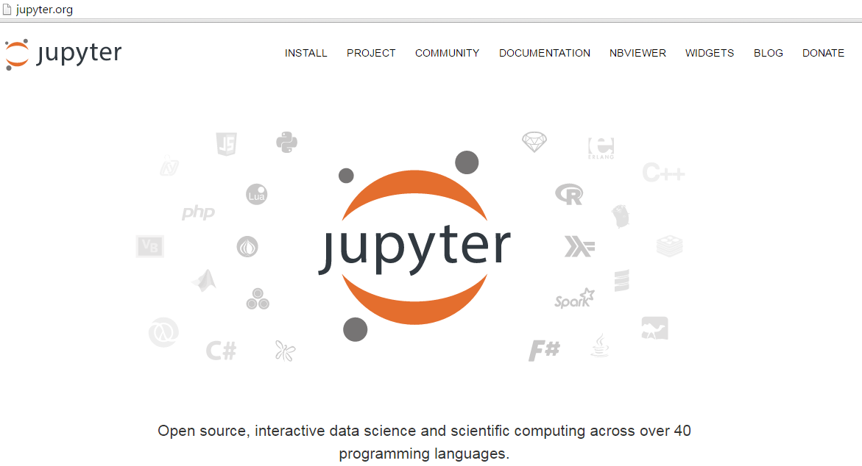
Heresy: I am not recommending that you start with R-Studio – even though it is great.
Home screen of Jupyter.org
Get instructions for installing R with Jupyter at http://blog.revolutionanalytics.com/2015/09/using-r-with-jupyter-notebooks.html
Notes:
Shea and Dihui and almost everyone I know who programs regularly in R recommends R-Studio. There are a few reasons why I recommend Jupyter instead:
It offers the same interface for 40 languages. Frankly, I am getting too old to have to remember a different IDE for each language I use. If is enough of a burden to remember the language itself.
Secondly, it is a wonderful way to provide documentation. You can show your input, your code, and the results, all in one document that is easily transferred from one PC or operating system to another along with decent markdown formatting capability for instructions.
OK, somebody out there is wondering, if R is so great, why does it matter that Jupyter can handle so many languages? Great question! My personal opinion is that no one language is the best tool for all situations. Just as a carpenter carries a saw and a hammer and other tools, you still need a spreadsheet and some other programming languages. Also, R is far from perfect. The free version needs to be able to have all the data in memory. There are workarounds for that but they are sometimes clumsy or sometimes not free – even expensive. Likewise, it is not ideal for multiprocessing and grid computing. However, the actuaries who started with Visicalc and Quattro and Lotus 1-2-3 had a huge head start with spreadsheets over those who waited until Microsoft made Excel viable. R may not be the ultimate language for you but it will certainly help you in the interim to get a competitive advantage. I am hoping that Jupyter, which was originally built for Julia, Python, and R , hence the name, will be a viable graphical interface for whatever newer language improvements come along.

Slide 8
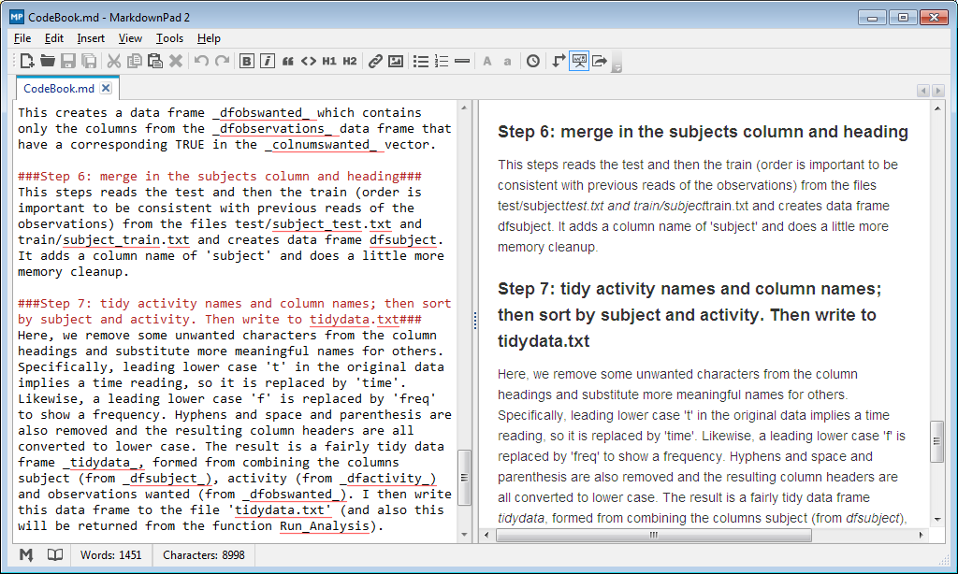
One of the best ideas I got from the Johns Hopkins courses was the importance of codebooks.
Notes:
Please read the great review of the Johns Hopkins series of online courses for their Data Science specialty that Shea Parkes wrote. I used their instructions on markdown language to create my documentation for the capstone of my third course and then I had to use a third party utility called MarkdownPad2 to actually see it formatted. This is another feature built into the JuPyteR notebooks.

Slide 9
R differs (from other languages) in the assignment syntax
Assignment of values to variables:
X = 5, X <- 5, 5-> X, assign(“X”,5) are identical
There are four ways to assign a value to a variable:
X=5 requires the least typing and is easily read by most folks familiar with other programming languages
X<-5 appeals to mathematicians, who always objected to the equals sign for assignment because of statements like x=x+1
5->x is another step towards clarity (put 5 into the variable x) but it is cumbersome when the left side is a long formula
Assign(‘x’,5) satisfies the purists; but involves the most typing. It is handy for generating dynamic code programmatically.
Bottom line: choose whatever assignment style you wish, but be prepared to read it in any of the four formats.
The convention seems to be X <- 5 for a variable and X=5 for a parameter

Slide 10
Quotes can be “ or ‘ but be consistent
Single or double quotes can be used to enclose strings. This allows you to use them in strings.
A<-‘abc’, B=”abc”, C<-“doesn’t cause error”, D=’it is ”OK” to include quotes in strings’
R is case sensitive:
ABC, abc, Abc, aBc, abC, ABc, AbC, aBC are eight different variables.“
most common variable types:
numeric (5.3, 7, pi),
character (‘a string’, “a string”),
Boolean (TRUE, FALSE, T, F)
to see type, use class(X)[1] "numeric"
to test type, use is.numeric(X), is.character(X), is.boolean(X), etc.

Slide 11
A few more tips:
Be careful; with the = assignment operator
x=10 assigns 10 to x
but x == 10 tests to see if x equals 10
Useful functions :
getwd() #get working directory[1] "C:/Users/Dave/Documents"
ls() #lists all objects currently defined
"loc" "num" "rules" "string" "system" "variables" "x" "X"
rm(num) #removes the object num from memory
ls()
"loc" "rules" "string" "system" "variables" "x" "X"
rm(list=ls()) #removes all objects from memory
ls()
character(0)

Slide 12
Quick demo of R in a JuPyteR notebook
Step 1: install miniConda
Get and install miniConda for Python 3 at http://conda.pydata.org/miniconda.html
Important: install python 3
Step 2: open an OS terminal window:
conda install -c r ipython-notebook r-irkernel ipython notebook
Get full instructions for installing R with Jupyter at http://blog.revolutionanalytics.com/2015/09/using-r-with-jupyter-notebooks.htm
Download demo notebook and related files at https://github.com/DaveSnell/Demo-of-R-in-Jupyter-notebook
Notes:
Now, I am going to take a huge risk and try a live demo. Please be kind!

Slide 13
R U up on R? Society of Actuaries Health Meeting – Philadelphia, PA 15-June-2016 10:00 – 11:30 am
By Dave Snell, ASA, MAAA, CLU, ChFC, FLMI, ACS, ARA, MCP
Technology Evangelist
RGA
14-June-2016
Notes:
Thank you for allowing me to come and speak with you today. In this session we are not going to make you proficient in R. But I hope we increase your interest in it and that we give you some tips for getting started with it.

